Slide 1

TRIBHUVAN UNIVERSITY
INSTITUTE OF ENGINEERING
PASCHIMANCHAL CAMPUS
A
PRESENTATION IN REGARD TO FINAL PROJECT DEFENCE
Performance Analysis on Placement and Sizing of D-STATCOM in Radial Distribution Network:
A Case study in Begnas Feeder, Lekhnath
Supervised By: Presented By:
Er. Sandeep Dhami Shankar Singh Thakuri
PAS 079MSDGE016
Notes:
Harmonics impact

Slide 2
Table of Content
Introduction
Problem Statement
Objectives
Methodology
Result and Discussion
Conclusion
Recommendation
References

Slide 3
INTRODUCTION
Distribution System has much garnered much attention due to significant role in power quality and planning.
Common issues persisting in the system include voltage sag, voltage instability and voltage fluctuations .
These problems encountered in the system lead to increase in losses, slow response time and decrease in power flow.
Conventional ways of resolving these issues and maintaining the voltages within stability limit in distribution system : By using shunt capacitor and series voltage regulator , but has certain limitations like that of delayed time response, inability of generation of continuous reactive power, present of oscillations in inductive circuit, etc.
To overcome these issues , FACTS devices like D-STATCOM, UPQC are extensively being used for low voltage distribution, improvement of power quality and reliability in power system.
D-STATCOM is a shunt connected VSC which has several advantages to its merit – such as low harmonic distortion, small in size, reduced losses , automated working, continuous operation, etc.
These devices need to be placed in optimal position to serve the required purpose.

Slide 4
PROBLEM STATEMENT
Maintaining the optimal voltage profile and minimizing losses in the distribution network remain formidable obstacles .
Research paper’s problem statement focuses on solving problems with reactive power management, improving voltage profiles, and lowering power losses in radial distribution system.
It draws attention to the drawbacks of employing capacitors for reactive power adjustment, including their propensity to cause oscillations and reliance on system voltage .
As a substitute, the study suggests using D-STATCOM , a static compensator based on a shunt-connected VSC.
In order to improve the effectiveness and efficiency of radial distribution networks, the study intends to identify the ideal placement and size of D-STATCOM utilizing voltage stability index ( VSI ) followed by size calculation through a variational technique .

Slide 5
OBJECTIVES
Main Objectives
The main objective of this project is to study the performance analysis of the placement and sizing of D-STATCOM in Radial distribution network of Begnas Feeder in Lekhnath , Pokhara.
Specific Objectives
To perform the base case load flow and observe the voltage profile and power loss of standard IEEE 33 Test bus and then Begnas Radial Feeder of Lekhnath using Backward Forward sweep algorithm in MATLAB
To find the sizing and the best candidate bus for the placement of D-STATCOM using VSI approach and variational technique in Begnas Radial Feeder
To analyze and compare the power losses before and after the placement of D-STATCOM in Begnas Feeder

Slide 6
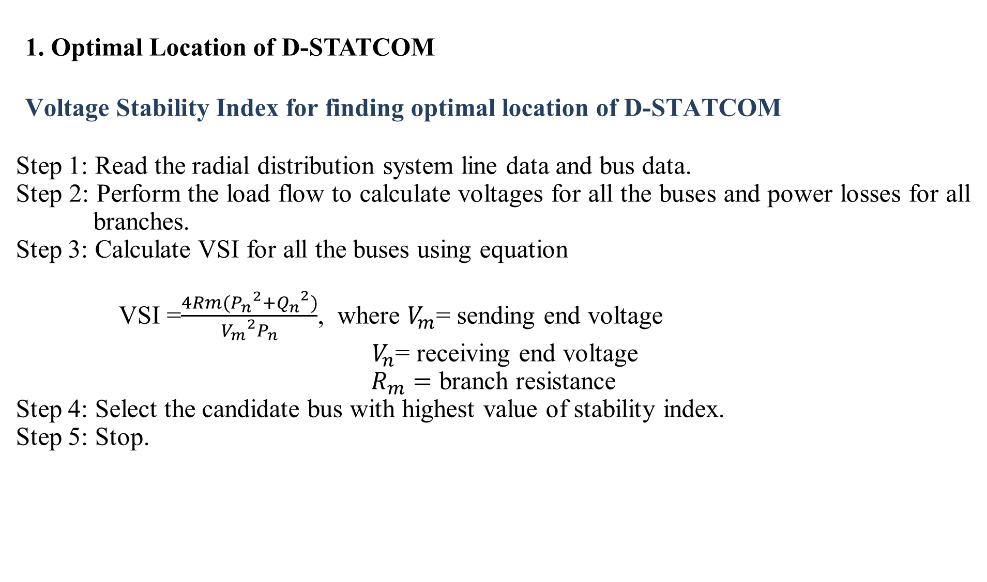
METHODOLOGY
1. Optimal Location of D-STATCOM
Voltage Stability Index for finding optimal location of D-STATCOM
Step 1: Read the radial distribution system line data and bus data.
Step 2: Perform the load flow to calculate voltages for all the buses and power losses for all branches.
Step 3: Calculate VSI for all the buses using equation
VSI =$\frac{4Rm({P_{n}}^{2}+{Q_{n}}^{2})}{{V_{m}}^{2}P_{n}}$, where $V_{m}$= sending end voltage
$V_{n}$= receiving end voltage
$R_{m}=$ branch resistance
Step 4: Select the candidate bus with highest value of stability index.
Step 5: Stop.

Slide 7
METHODOLOGY
2.Optimal size calculation by variational technique
Step 1: Read the line data and bus data and find the candidate bus for D-STATCOM placement by sensitivity method VSI.
Step 2: Place the D-STATCOM at candidate bus with size varying in steps of 50 KVAR
Step 3: Find the losses after placement of D-STATCOM.
Step 4: Select the size of D-STATCOM which gives minimum losses.
Step 5: Stop.

Slide 8
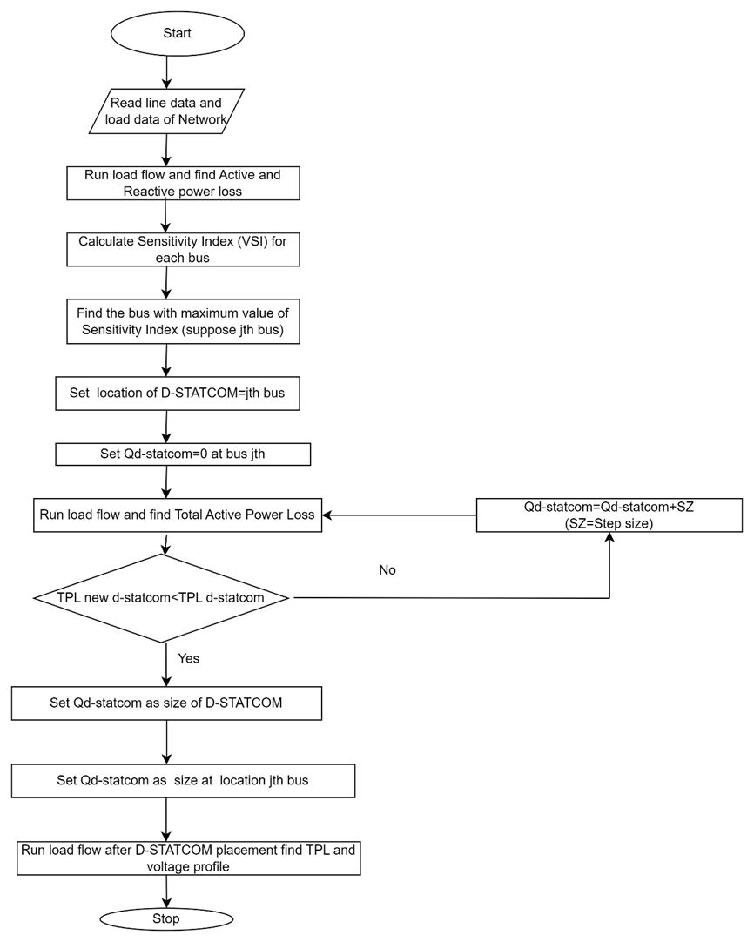
FLOW CHART OF PROPOSED PROJECT

Slide 9
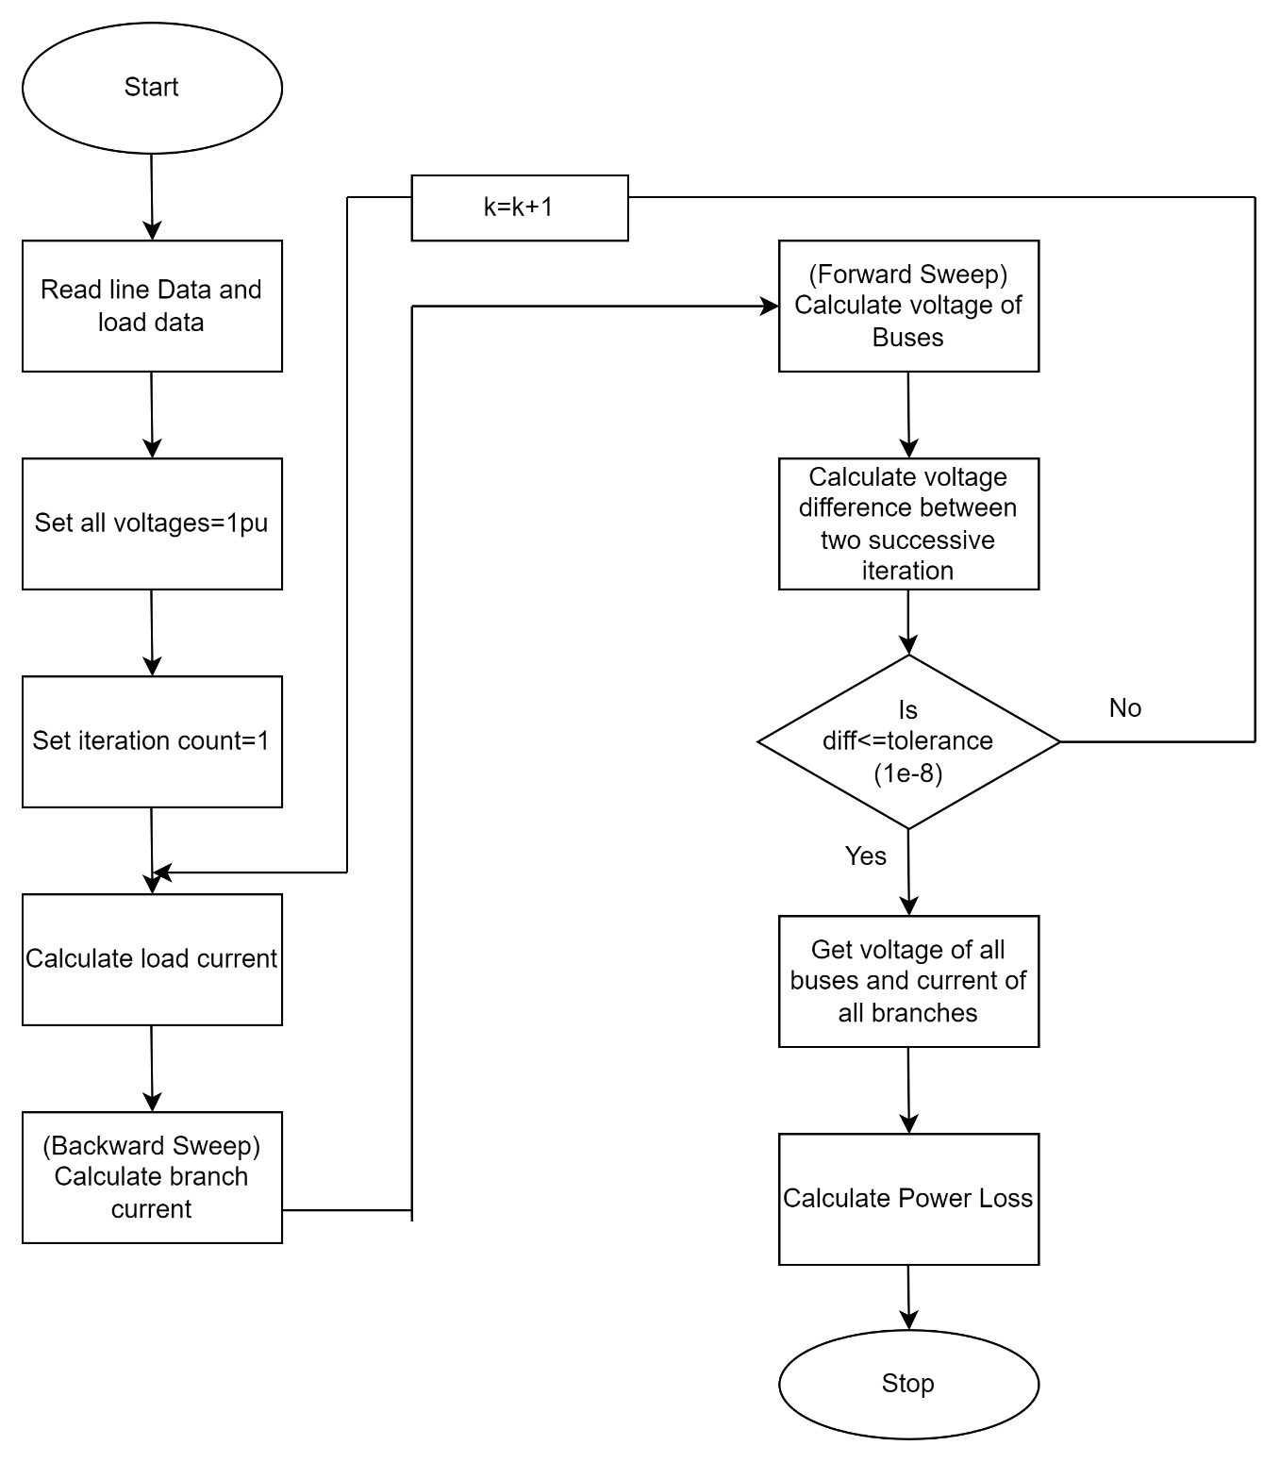
Flow chart for Load Flow Analysis(Backward forward)

Slide 10
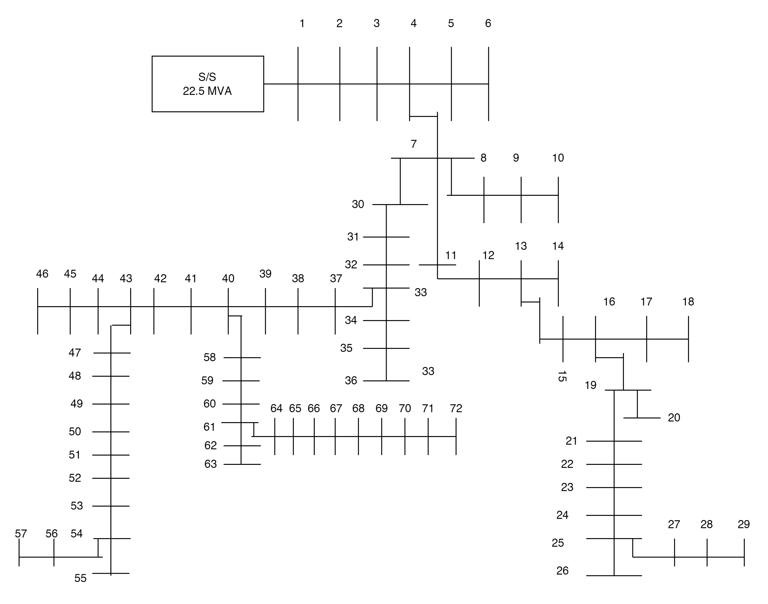
DATA COLLECTION
SLD of Begnas Feeder

Slide 11
RESULT AND DISCUSSION
Voltage Profile of Begnas Feeder in Base Case
Bus No | Voltage (pu) | Branch No | Active Power Loss(KW) | Reactive Power Loss(KVAR)
1 | 1 | 1 | 0 | 0
2 | 0.994313148 | 1-2 | 25.98540153 | 29.81931323
3 | 0.986543414 | 2-3 | 35.12130338 | 40.30313502
4 | 0.982950887 | 3-4 | 16.16423758 | 18.54912509
5 | 0.982617885 | 4-5 | 0.035539319 | 0.021849279
6 | 0.982361875 | 5-6 | 0.018216972 | 0.011199643
7 | 0.976623293 | 4-7 | 27.15561829 | 31.16218492
8 | 0.976233884 | 7-8 | 0.121884953 | 0.139867979
9 | 0.976163065 | 8-9 | 0.013301777 | 0.015264334
10 | 0.976077885 | 9-10 | 0.005333521 | 0.006120434
11 | 0.973325205 | 7-11 | 4.31250971 | 2.651295197
12 | 0.970971121 | 11-12 | 2.739771982 | 1.684389088
13 | 0.969435339 | 12-13 | 1.676767618 | 1.030862823
14 | 0.969386135 | 13-14 | 0.003557572 | 0.002187166
15 | 0.966985927 | 13-15 | 2.497482506 | 1.535431528
16 | 0.966012486 | 15-16 | 0.851490205 | 0.523489115
17 | 0.965058247 | 16-17 | 0.138725945 | 0.08528756
18 | 0.964397768 | 17-18 | 0.048029566 | 0.029528178
19 | 0.964905768 | 16-19 | 0.706216649 | 0.810412548
20 | 0.964684293 | 19-20 | 0.008051787 | 0.004950172
21 | 0.963651534 | 19-21 | 0.681071554 | 0.781557521
22 | 0.962876956 | 21-22 | 0.371414576 | 0.426213448
23 | 0.962129183 | 22-23 | 0.382401834 | 0.235097475
24 | 0.961017212 | 23-24 | 0.32530236 | 0.199993192
25 | 0.960272808 | 24-25 | 0.163405398 | 0.100460283
26 | 0.95999463 | 25-26 | 0.010855688 | 0.004108394
27 | 0.959494598 | 25-27 | 0.121578347 | 0.046011989
28 | 0.95918261 | 27-28 | 0.036559866 | 0.013836281
29 | 0.958897404 | 28-29 | 0.011142728 | 0.004217026
30 | 0.955846744 | 29-30 | 8.710958792 | 9.99618222
31 | 0.951252375 | 30-31 | 12.84529369 | 14.74050096
32 | 0.947446504 | 31-32 | 10.41370752 | 11.95015617
33 | 0.944042486 | 32-33 | 9.106792226 | 10.45041731
34 | 0.943709067 | 33-34 | 0.06603901 | 0.07578247
35 | 0.94350606 | 34-35 | 0.020110158 | 0.023077231
36 | 0.94341839 | 35-36 | 0.002895373 | 0.00332256
37 | 0.940436875 | 33-37 | 8.948138897 | 10.26835611
38 | 0.935785205 | 37-38 | 10.94908656 | 12.56452556
39 | 0.928418329 | 38-39 | 16.89773465 | 19.39084304
40 | 0.922072188 | 39-40 | 14.39158268 | 16.51493095
41 | 0.920273036 | 40-41 | 1.893130829 | 2.172445214
42 | 0.919357118 | 41-42 | 0.90099725 | 1.033931271
43 | 0.918155344 | 42-43 | 1.141147237 | 1.309513222
44 | 0.917203796 | 43-44 | 0.09767931 | 0.036967268
45 | 0.916706085 | 44-45 | 0.030662629 | 0.011604439
46 | 0.916558504 | 45-46 | 0.003031051 | 0.001147118
47 | 0.915902638 | 43-47 | 1.944711275 | 2.23163589
48 | 0.914006525 | 47-48 | 1.572383353 | 1.804374339
49 | 0.91174654 | 48-49 | 1.79687188 | 2.061984125
50 | 0.910367051 | 49-50 | 0.611116283 | 0.701280981
51 | 0.909612124 | 50-51 | 0.174337775 | 0.200059742
52 | 0.908294913 | 51-52 | 0.246607544 | 0.093329972
53 | 0.907072223 | 52-53 | 0.178155637 | 0.067423974
54 | 0.905924804 | 53-54 | 0.119489368 | 0.045221404
55 | 0.905518884 | 54-55 | 0.016905176 | 0.006397856
56 | 0.90526275 | 54-56 | 0.04137339 | 0.015657985
57 | 0.905072053 | 56-57 | 0.003972961 | 0.001503589
58 | 0.919032137 | 40-58 | 3.711482937 | 4.25907878
59 | 0.914356977 | 58-59 | 5.993611825 | 3.684822832
60 | 0.908681704 | 59-60 | 6.393444671 | 3.930636749
61 | 0.901386576 | 60-61 | 7.937571636 | 4.879953199
62 | 0.900804347 | 61-62 | 0.04874443 | 0.018447596
63 | 0.900399541 | 62-63 | 0.016949278 | 0.006414547
64 | 0.895738511 | 61-64 | 5.252013787 | 3.22889451
65 | 0.89122954 | 64-65 | 4.105217855 | 2.523853884
66 | 0.888738105 | 65-66 | 2.068583638 | 1.271748061
67 | 0.883913519 | 66-67 | 3.812577377 | 2.343940945
68 | 0.880336771 | 67-68 | 2.536859384 | 1.559640106
69 | 0.877560601 | 68-69 | 1.856311186 | 1.141244719
70 | 0.873831146 | 69-70 | 2.41826034 | 1.486726398
71 | 0.870953993 | 70-71 | 1.628862987 | 1.001411453
72 | 0.867303993 | 71-72 | 1.916012357 | 1.177948504
 |  |  | 272.5285894 | 280.4847242

Slide 12
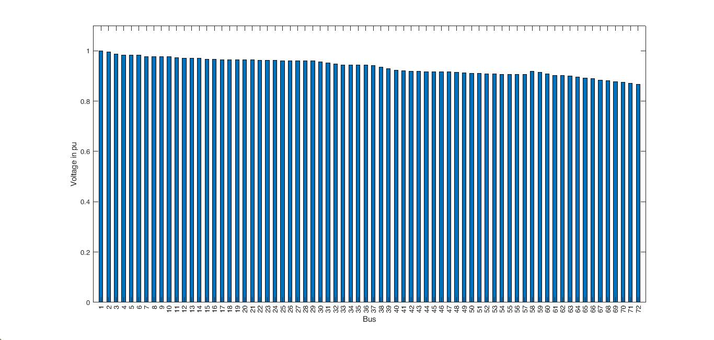

Slide 13
2. Active and Reactive Power Loss of Begnas Feeder in Base Case
Bus No | Voltage (pu) | Branch No | Active Power Loss(KW) | Reactive Power Loss(KVAR)
1 | 1 | 1 | 0 | 0
2 | 0.994313148 | 1-2 | 25.98540153 | 29.81931323
3 | 0.986543414 | 2-3 | 35.12130338 | 40.30313502
4 | 0.982950887 | 3-4 | 16.16423758 | 18.54912509
5 | 0.982617885 | 4-5 | 0.035539319 | 0.021849279
6 | 0.982361875 | 5-6 | 0.018216972 | 0.011199643
7 | 0.976623293 | 4-7 | 27.15561829 | 31.16218492
8 | 0.976233884 | 7-8 | 0.121884953 | 0.139867979
9 | 0.976163065 | 8-9 | 0.013301777 | 0.015264334
10 | 0.976077885 | 9-10 | 0.005333521 | 0.006120434
11 | 0.973325205 | 7-11 | 4.31250971 | 2.651295197
12 | 0.970971121 | 11-12 | 2.739771982 | 1.684389088
13 | 0.969435339 | 12-13 | 1.676767618 | 1.030862823
14 | 0.969386135 | 13-14 | 0.003557572 | 0.002187166
15 | 0.966985927 | 13-15 | 2.497482506 | 1.535431528
16 | 0.966012486 | 15-16 | 0.851490205 | 0.523489115
17 | 0.965058247 | 16-17 | 0.138725945 | 0.08528756
18 | 0.964397768 | 17-18 | 0.048029566 | 0.029528178
19 | 0.964905768 | 16-19 | 0.706216649 | 0.810412548
20 | 0.964684293 | 19-20 | 0.008051787 | 0.004950172
21 | 0.963651534 | 19-21 | 0.681071554 | 0.781557521
22 | 0.962876956 | 21-22 | 0.371414576 | 0.426213448
23 | 0.962129183 | 22-23 | 0.382401834 | 0.235097475
24 | 0.961017212 | 23-24 | 0.32530236 | 0.199993192
25 | 0.960272808 | 24-25 | 0.163405398 | 0.100460283
26 | 0.95999463 | 25-26 | 0.010855688 | 0.004108394
27 | 0.959494598 | 25-27 | 0.121578347 | 0.046011989
28 | 0.95918261 | 27-28 | 0.036559866 | 0.013836281
29 | 0.958897404 | 28-29 | 0.011142728 | 0.004217026
30 | 0.955846744 | 29-30 | 8.710958792 | 9.99618222
31 | 0.951252375 | 30-31 | 12.84529369 | 14.74050096
32 | 0.947446504 | 31-32 | 10.41370752 | 11.95015617
33 | 0.944042486 | 32-33 | 9.106792226 | 10.45041731
34 | 0.943709067 | 33-34 | 0.06603901 | 0.07578247
35 | 0.94350606 | 34-35 | 0.020110158 | 0.023077231
36 | 0.94341839 | 35-36 | 0.002895373 | 0.00332256
37 | 0.940436875 | 33-37 | 8.948138897 | 10.26835611
38 | 0.935785205 | 37-38 | 10.94908656 | 12.56452556
39 | 0.928418329 | 38-39 | 16.89773465 | 19.39084304
40 | 0.922072188 | 39-40 | 14.39158268 | 16.51493095
41 | 0.920273036 | 40-41 | 1.893130829 | 2.172445214
42 | 0.919357118 | 41-42 | 0.90099725 | 1.033931271
43 | 0.918155344 | 42-43 | 1.141147237 | 1.309513222
44 | 0.917203796 | 43-44 | 0.09767931 | 0.036967268
45 | 0.916706085 | 44-45 | 0.030662629 | 0.011604439
46 | 0.916558504 | 45-46 | 0.003031051 | 0.001147118
47 | 0.915902638 | 43-47 | 1.944711275 | 2.23163589
48 | 0.914006525 | 47-48 | 1.572383353 | 1.804374339
49 | 0.91174654 | 48-49 | 1.79687188 | 2.061984125
50 | 0.910367051 | 49-50 | 0.611116283 | 0.701280981
51 | 0.909612124 | 50-51 | 0.174337775 | 0.200059742
52 | 0.908294913 | 51-52 | 0.246607544 | 0.093329972
53 | 0.907072223 | 52-53 | 0.178155637 | 0.067423974
54 | 0.905924804 | 53-54 | 0.119489368 | 0.045221404
55 | 0.905518884 | 54-55 | 0.016905176 | 0.006397856
56 | 0.90526275 | 54-56 | 0.04137339 | 0.015657985
57 | 0.905072053 | 56-57 | 0.003972961 | 0.001503589
58 | 0.919032137 | 40-58 | 3.711482937 | 4.25907878
59 | 0.914356977 | 58-59 | 5.993611825 | 3.684822832
60 | 0.908681704 | 59-60 | 6.393444671 | 3.930636749
61 | 0.901386576 | 60-61 | 7.937571636 | 4.879953199
62 | 0.900804347 | 61-62 | 0.04874443 | 0.018447596
63 | 0.900399541 | 62-63 | 0.016949278 | 0.006414547
64 | 0.895738511 | 61-64 | 5.252013787 | 3.22889451
65 | 0.89122954 | 64-65 | 4.105217855 | 2.523853884
66 | 0.888738105 | 65-66 | 2.068583638 | 1.271748061
67 | 0.883913519 | 66-67 | 3.812577377 | 2.343940945
68 | 0.880336771 | 67-68 | 2.536859384 | 1.559640106
69 | 0.877560601 | 68-69 | 1.856311186 | 1.141244719
70 | 0.873831146 | 69-70 | 2.41826034 | 1.486726398
71 | 0.870953993 | 70-71 | 1.628862987 | 1.001411453
72 | 0.867303993 | 71-72 | 1.916012357 | 1.177948504
 |  |  | 272.5285894 | 280.4847242

Slide 14
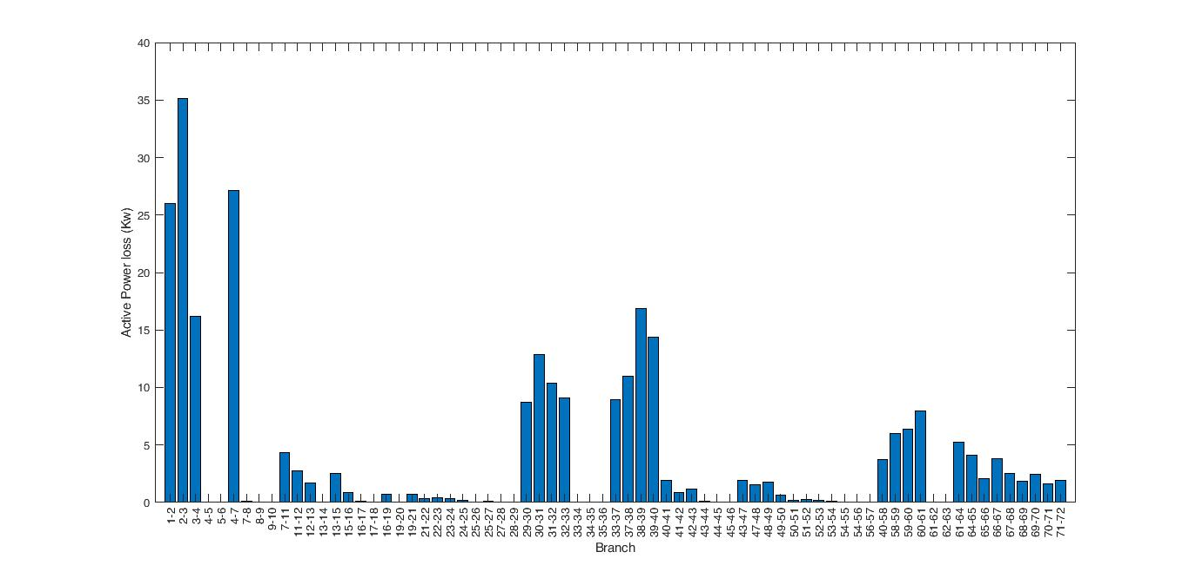
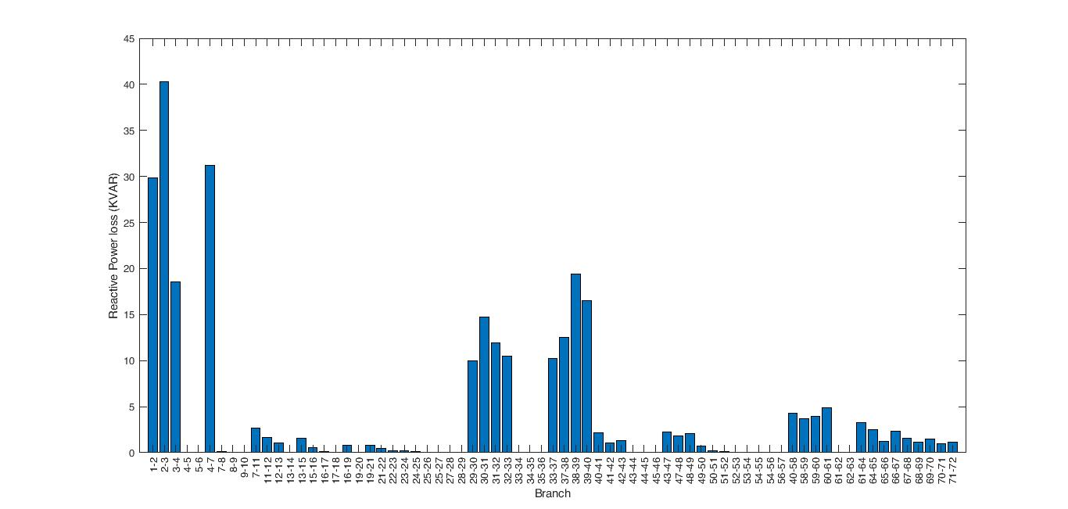
Fig : Active Power Loss
Fig : Reactive Power Loss

Slide 15
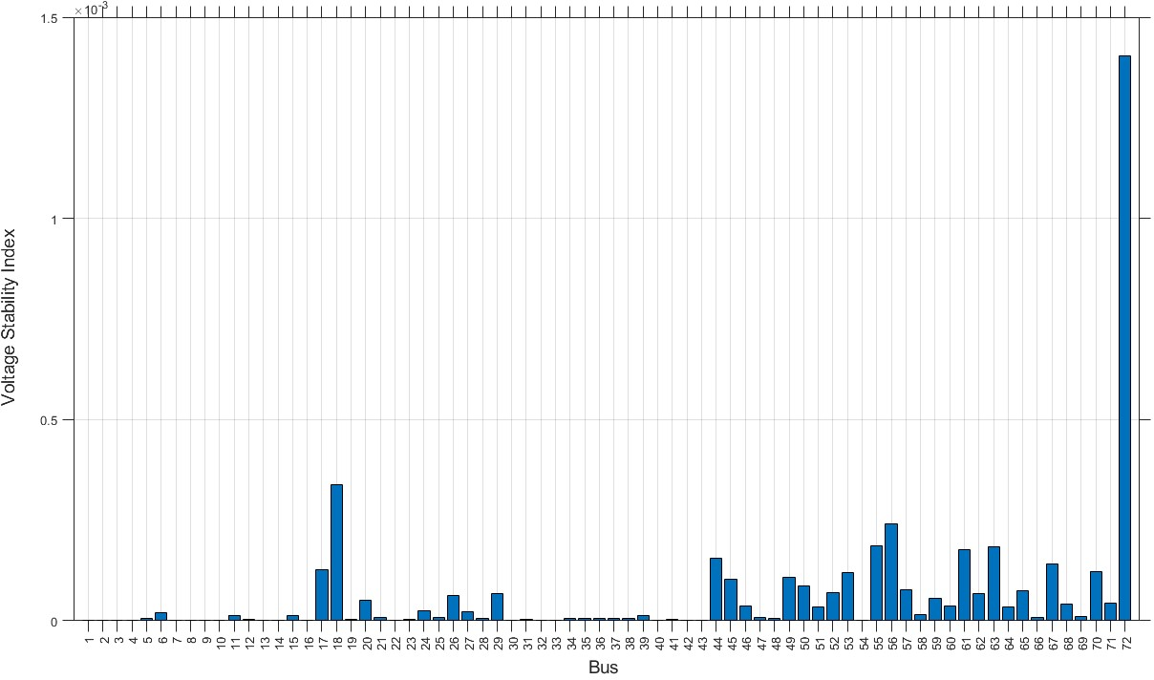
3. Voltage Stability Index Calculation for each bus
VSI is highest at bus 72 which is of value 0.0014

Slide 16
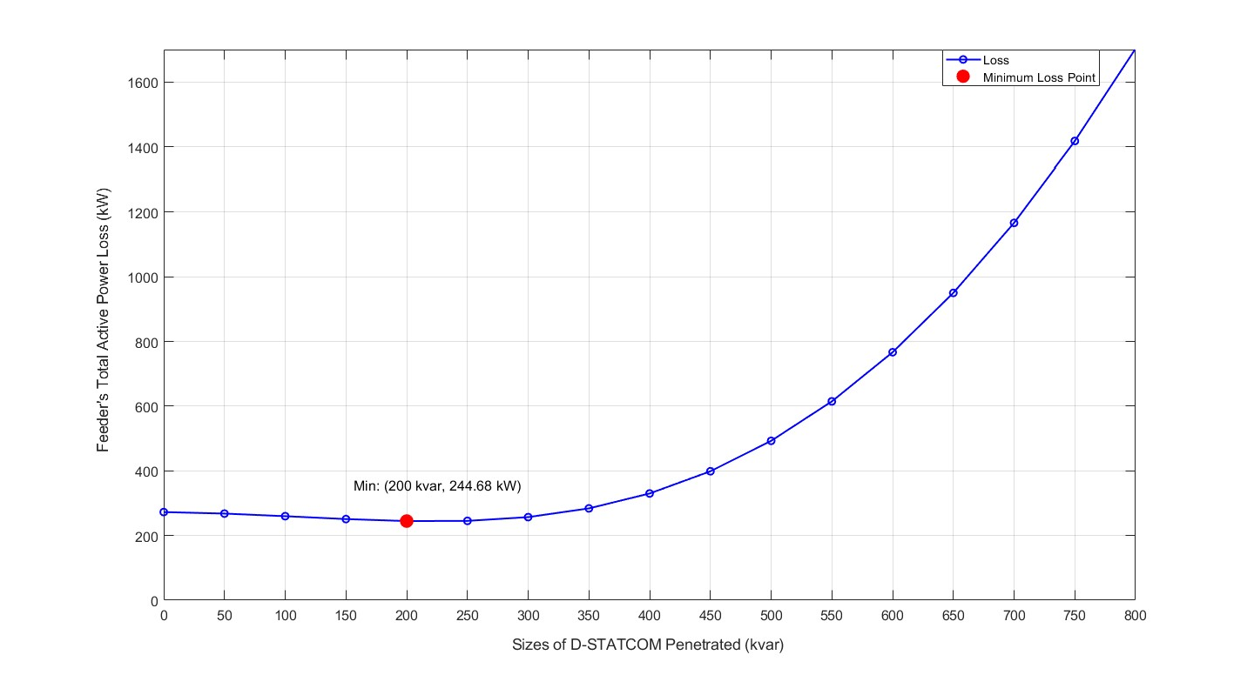
4.Total Active Power Loss vs Incremental Sizes of D-STATCOM

Slide 17
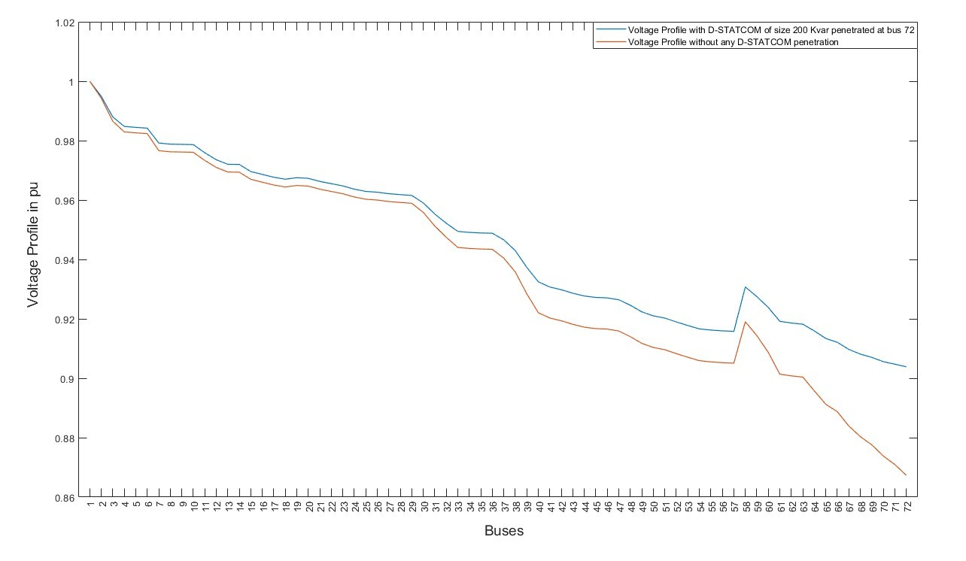
5.Voltage profile Comparison between base case and after D-STATCOM placement at bus 72 of size 200kvar

Slide 18
CONCLUSION
The load flow analysis, voltage stability index analysis, and variational techniques were employed in this work.
200kvar size of D- STATCOM was placed at Bus-72 for the reactive power compensation and eventually voltage profile improvement
The corresponding line loss was found to be 244.68kW which is an improvement of 10.21 % than the base case scenario (272.528 kW)

Slide 19
RECOMMENDATION
Voltage profile still couldn’t meet the voltage regulation standards so it recommended to incorporate the optimization algorithm for finding the size and location as they are corelated parameter for optimal sizing and placement

Slide 20
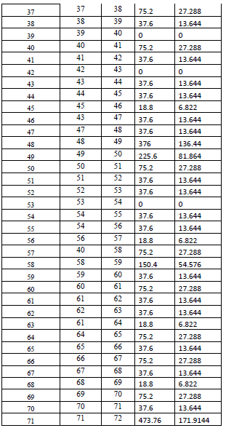
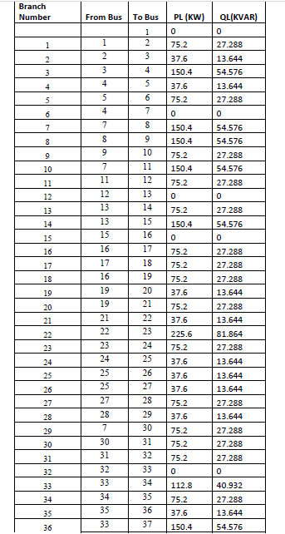
APPENDIX
Load Data of Begnas Feeder

Slide 21
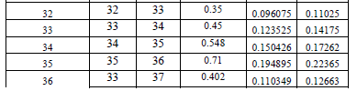
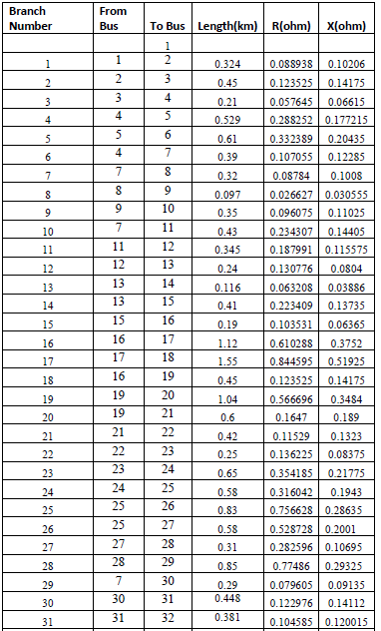
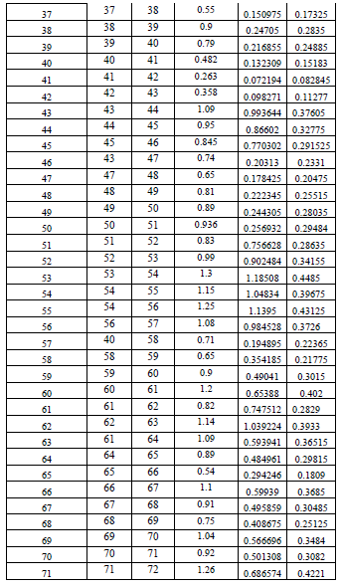
Line Data of Begnas Feeder

Slide 22
REFERENECES
[1] Subbarami Reddy1, V Usha Reddy2, "Optimal Placement of D-STATCOM in Radial Distribution System using Fuzzy and Penguins Search Optimization Algorithm," Innovative research in electrical, electronics, instrumentation and control engineering, Vols. Vol. 3,, no. Issue 11, pp. 102-106, November 2015.
[2.] Y. T. Gebreyes, "Studies on voltage control of distribution substations using static var compensators," Addis Ababa institute of technology, Addis Ababa, 2019.
[3.] T.Taye,"Improvement of Distribution Feeder Loss and Voltage Profile (Case Study:Bella Substation Distribution Feeder)," Addis Ababa university, Addis Ababa, Ethiopia, October, 2019“
[4.] S M Suhail Hussain, "An Analytical Approach for Optimal Location of D- STATCOM in Radial Distribution System," in msubbaramiah, Mahboobnagar, India., 22 December 2018..
[5]. "Bonyadi, M. R.; Michalewicz, Z. (2017). "Particle swarm optimization for single objective continuous space problems: a review". Evolutionary Computation." (n.d.).
[6]."Optimal placement of DG and DSTATCOM for loss reduction and voltage profile improvement." (n.d.).
[7]."Whale optimization algorithm for optimal sizing of renewable resources for loss reduction in distribution systems." (n.d.).

Slide 23
[8]. "I. Y. Djilani Kobibi, S. Hadjeri, and M. A. Djehaf." “Study of UPFC Optimal Location Considering Loss Reduction and Improvement of Voltage Stability in Power System (n.d.). Leonardo Journal of Sciences. Issue.
[9]. Gupta AR, Kumar A (2015) Energy savings using D-STATCOM placement in radial distribution system. Procedia Comput Sci70:558–564.
[10] Gupta, A.R.; Jain, A.; Kumar, A. Optimal D-STATCOM placement in radial distribution system based on power loss index approach. In Proceedings of the 2015 International Conference on Energy, Power and Environment: Towards Sustainable Growth (ICEPE), Shillong, India, 12–13 June 2015; pp. 1–5.

Slide 24
THANK YOU

